Slide 1
Design of Hash functions
and
Some Attacks
Mridul Nandi
Indian Statistical Institute, Kolkata
ACM School

Slide 2
What is a
hash function?

Slide 3
Hash Function
Algebraic hash function.
algebraic objects such as group, ring , field etc.
Keyed - e.g. H_{K}(M) = K . M where K ←$ F₂^{n} and M ∈ F₂^{n}.
Cryptographic hash function.
It uses some atmoic operations, e.g. bit-wise rotation, xor, shift, modular addition, multiplication, S-box etc.
H : M → {0,1}^{n}. A public function (anybody can compute)
M is called message space, n is called the hash-size.
Message space: {0,1}*, {0,1} , ({0,1}^{w})* where w is word-size.
Hash size: n = 128, 160, 224, 256, 384, 512 etc.
2⁶⁴
Notes:
For F = RF q can be anything…
For a small size F q can not be large…
Trade-off between performance and security..

Slide 4
What we demand from a good hash function?

Slide 5
Hash Function
All cryptographic objects or building blocks have two features (in general)
(1) correctness: what we want to achieve minimally
(2) Security: What we achieve extra features from a good building blocks to protect us from bad people?
Notes:
For F = RF q can be anything…
For a small size F q can not be large…
Trade-off between performance and security..

Slide 6
Hash Function
(1) correctness: what we want to achieve minimally
Encryption: efficiently computable inverse.
Hash function: efficiently computable function mapping to outputs of fixed length.
(2) Security: What we achieve extra features from a good building blocks to protect us from bad people?
Encryption: given plaintexts and ciphertexts, the key should not be revealed.
Hash function:, we have (many) security goals from a good cryptographic hash function. Make a list later.
Notes:
For F = RF q can be anything…
For a small size F q can not be large…
Trade-off between performance and security..

Slide 7
Examples of
Hash Functions.

Slide 8
Examples of Hash Function
Traditional hash: MD4, MD5 (Ron Rivest)
Widely used… Some weakness observed.
finally MD6 (again by Rivest and his team)
SHA-0, SHA-1, SHA-2 (SHA-224, SHA-256, SHA- 384, SHA-512) designed by the National Security Agency (NSA) and published by the NIST.
Again some weakness in SHA-0 and even SHA-1 are observed.
SHA-3 competition called by NIST.
History of the SHA3-competition.
Current status: five finalists have been selected.
They are: Blake, Grostl , JH, Keccak, and Skein
In 2012, Keccak was selected as the SHA3 winner.
For more information: SHA3-zoo, NIST web-page.

Slide 9
Different types of Hash Function

Slide 10
Hash Function
Un-keyed hash function: H : M → {0,1}^{n}.
M is called message space, n is called the hash-size.
It may involve some pre-specified constants such as initial value IV.
Used for data integrity: send (M, H(M)) where H(M) plays role of check-sum.
Used as a pre-processors: e.g. Digital signature.
Notes:
For F = RF q can be anything…
For a small size F q can not be large…
Trade-off between performance and security..

Slide 11
Hash Function
Un-keyed hash function: H : M → {0,1}^{n}.
M is called message space, n is called the hash-size.
It may involve some pre-specified constants such as initial value IV.
Used for data integrity: send (M, H(M)) where H(M) plays role of check-sum.
Used as a pre-processors: e.g. Digital signature.
Salted Hash function: takes other special input, called salt. H : M x S → {0,1}^{n} .
Salt is chosen at random from the salt space S and then made it public (or attached with the hash value).
M is a message, s ←$ S , compute h = H(M, s) and send (M, h, s) so that receiver can check data integrity.
Notes:
For F = RF q can be anything…
For a small size F q can not be large…
Trade-off between performance and security..

Slide 12
Hash Function
Keyed hash function: H_{K} : M → {0,1}^{n}, K ∈ K (key-space) .
Used for authentications. Alice and Bob have pre-shared key K. Alice wants to send a message M to Bob correctly (no privacy).
Alice sends (M, H_{K}(M)) to Bob, and Bob can verify it. A good keyed hash function guarantees that the message must be M (message authentication) and only Alice can send the message (identity authentication).
To make use of unkeyed hash function: Define H_{K}(M) = H(K || M).
Popular approach but is NOT secure always: Later we see that for Markle-Damgard H(), we have length-extension attack.
Like salt, key is chosen at random. Unlike salt, key is kept secret.
Notes:
For F = RF q can be anything…
For a small size F q can not be large…
Trade-off between performance and security..

Slide 13
Some Applications of Hash Function

Slide 14
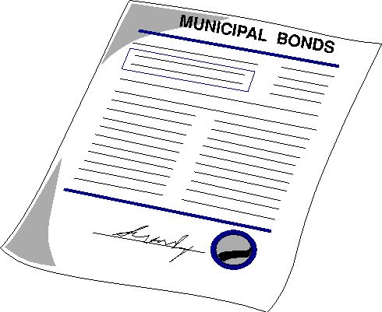
Application: Hash Function
1. Digital Signature : Let sig_{SK} be a signature algorithm over {0,1}^{n}. We define SIG_{SK} over M as
-- SIG_{SK}(M) = sig_{SK}(H(M)).
1. Make message compatible with signature algorithm.
2. Random looking hash output
3. Much faster algorithm
Hash Function should be Collision resistance:
Hard to find M ≠ M’ such that H(M) = H(M’).
Hash
Digital Signature
Algorithm sig_{SK}
Value of Digital Signature
If H is not CR then what is the problem??

Slide 15
Application: Hash Function
2. Bit-commitment: To commit a message M, make c = H(M) public.
Hiding property: preimgae resistance: (given c, hard to find M).
Binding property: hard to change the commitment i.e. to find a message M’ such that H(M’) = c.
- collision resistance, 2nd preimage resistant (given Mhard to find M ≠ M’ such that H(M) = H(M’) ).
This works for long message. How one can commit for a single bit b?
Choose a long random string r and commit b||r instead of b.
One can append the random string for M also.

Slide 16
Other Applications
Message authentication: E.g. HMAC (Bellare et al.)
Public Key Encryption (Kurosawa-Desmedt, Cramer-Shoup, DHIES etc.).
Identity based Public Key Encryption (Boneh et al.) (public-key encryption with identity (e.g. gmail-id) as a public key).
Key extraction: Given a long key-stream with less entropy how one can compute a smaller key-size with full entropy.
A possible solution is to apply a good hash function to the long key-stream.

Slide 17
We have already heard some security requirements, now
we make a list…

Slide 18
Security Requirements: Hash Function
(The MOST POPULAR)
(1) collision resistance.
(2) Preimage resistant.
The others
(3) 2nd preimage resistant
(4) multicollision resistant.
(5) Target collision resistant
or UOWHF.
(6) resistant against length-extension attack
(7) Herding attack.
(8) indistinguishability in outputs. PRF, PRO..
ETC…

Slide 19

Security Requirements: Hash Function
(The MOST POPULAR)
(1) collision resistance.
(2) Preimage resistant.
The others
(3) 2nd preimage resistant
(4) multicollision resistant.
(5) Target collision resistant
or UOWHF.
(6) resistant against length-extension attack
(7) Herding attack.
(8) indistinguishability in outputs. PRF, PRO..
ETC…

Slide 20
Security Requirements: Hash Function
(The MOST POPULAR)
(1) collision resistance.
(2) Preimage resistant.
The others
(3) 2nd preimage resistant
(4) multicollision resistant.
(5) Target collision resistant
or UOWHF.
(6) resistant against length-extension attack
(7) Herding attack.
(8) indistinguishability in outputs. PRF, PRO..
ETC…
SWISS ARMY KNIFE

Slide 21

Security Requirements: Hash Function
(The MOST POPULAR)
(1) collision resistance.
(2) Preimage resistant.
The others
(3) 2nd preimage resistant
(4) multicollision resistant.
(5) Target collision resistant
or UOWHF.
(6) resistant against length-extension attack
(7) Herding attack.
(8) indistinguishability in outputs. PRF, PRO..
ETC…
SWISS ARMY KNIFE

Slide 22
We still have a long list of security requirements for today, so let’s begin with
collision resistant

Slide 23
Merkle-Damgård (Crypto-89)
Let f: {0,1}^{n+d} → {0,1}^{n} be a compression function. Given a message M find smallest r ≥ 0 such that |M|+ 65 + r is multiple of d. Append 10^{r} || binary(|M|)₆₄ .
- Pad(M) = M || 10…00 || binary(|M|)₆₄ = M₁ || … || M_{t}
M₁
M₂
…
M_{t-1}
M_{t}
d-bit
d-bit
d-bit
d-bit
f
f
…
f
f
IV
hash value
= MD_{IV}(M)
n-bit
n-bit
n-bit
n-bit
n-bit
f is CR F is CR. (Merkle,Damgård 1989).
Can you prove this? (Exercise)

Slide 24
Merkle-Damgård preserves CR (Proof)
To prove this we need to prove the following:
We can write down an algorithm for
finding collision of f given a collision of H.
So assume (M, N) is a collision of H and find out a collision for f.

Slide 25
Keyed Merkle-Damgård (‘89)
Use key as an initial value: MD_{K}(M).
Prepend key to the message block: MD_{IV}(K||M)
M₂
…
M_{t-1}
M₁
d-bit
d-bit
d-bit
d-bit
f
f
…
f
K
HV1
n-bit
n-bit
n-bit
n-bit
H has length extension attack

Slide 26
Keyed Merkle-Damgård (‘89)
Use key as an initial value: MD_{K}(M).
Prepend key to the message block: MD_{IV}(K||M)
M₂
…
M_{t-1}
M_{t}
M₁
d-bit
d-bit
d-bit
d-bit
f
f
…
f
f
K
HV2
= f(HV1, M_{t})
n-bit
n-bit
n-bit
n-bit
n-bit
H has length extension attack
Hash based Password authentication is vulnerable to Length extension attack.
Similar attack can be obtained for MD_{IV}(K || M).

Slide 27
MD is good and bad both…
Are there any other examples?

Slide 28
MD is good and bad both…
Are there any other examples?
YES

Slide 29
Designs of Hash Function
We design hash function from a smaller domain function called base function (e.g. compression function).
E.g. Merkle-Damgård.
There are other variants of MD.
Chop-MD, MD with post-processor.
Haifa.
Concatenated MD.
Doubly iterated, Zipper hash, Generalized MD.
A sequential design based on non-compressing function
Sponge Hash function.
Now we study the above design of hash functions one by one.
Notes:
For F = RF q can be anything…
For a small size F q can not be large…
Trade-off between performance and security..

Slide 30
1. Chop-MD (Coron et al. Crypto 2005)
… … …
Chopping s bits
M₁
M₂
M₃
M_{t-1}
M_{t}
IV
f
f
f
f
f
h_{t}
n-bit
n-bit
n-bit
n-bit
n-s bits

Slide 31
2. MD with Post Processor
g: {0,1}^{n} → {0,1}^{m} be any function, m ≤ n , called post-processor (chop is one example).
M₂
…
M_{t-1}
M_{t}
M₁
d-bit
d-bit
d-bit
d-bit
g
f
f
…
f
f
H.V.
IV
n-bit
n-bit
n-bit
n-bit
n-bit
m-bit

Slide 32
3. HAIFA (Biham et al.)
Compression function can take counter along with message block and chaining value.
It protects from length extension attack (recall it for MD) and long-message 2nd preimage attack (we describe later).
(1,M₁)
(2,M₂)
(3,M₃)
…
(t-1,M_{t-1})
(0,M_{t})
…
IV
f
f
f
f
f
h_{t}
n-bit
n-bit
n-bit
n-bit

Slide 33
In some application we need larger hash size.
Notes:
For F = RF q can be anything…
For a small size F q can not be large…
Trade-off between performance and security..

Slide 34
4. Concatenated Hash function
In some application we need larger hash size.
One solution: Design a compression function with large n.
Double block length hash function: From n-bit compression function how to design 2n-bit hash function.
Range extension vs Domain Extension.
H and G n-bit hash function then H(M) || G(M) is a 2n-bit hash function.
Widely used in many industries.
Common belief: If H and G are good hash functions and independently designed then H || G has strength like an ideal 2n-bit hash function. - NOT TRUE ALWAYS… (we will see later)
Notes:
For F = RF q can be anything…
For a small size F q can not be large…
Trade-off between performance and security..

Slide 35
We know some hash designs ...
Which designs SHA-3 finalists use?

Slide 36
SHA-3 Five finalists
Blake: HAIFA MD design.
f(h, m, ctr) = h’. We increase counter one by one in MD chain.
Salt can be incorporated.
Grostl: MD with non-trivial post processor .
Chain size: 2n. Post-processor: 2n → n.
JH: chop-MD
Chain size: 2n. chop: 2n → n.
Keccak: Sponge mode.
Skein: MD with post-processor.

Slide 37
and SHA-3 is
Keccak: Sponge mode.
Designed by
Guido Bertoni,
Joan Daemen,
Michaël Peeters, and
Gilles Van Assche

Slide 38
Sponge Mode
M1
M2
M3
Mk
IV₁
Hash value
P
P
P
IV₂
drop
P: {0,1} ^{r+c} → {0,1} ^{r+c} be a function (permutation).
|IV₁| = r (bit-rate or hash rate) and |IV₂| =c (capacity measure security guarantee).
Can be used for
Arbitrary length hash outputs.
stream-cipher.

Slide 39
We talked about a lot of designs. Let’s go back to security… rather
some generic attacks…

Slide 40
Birthday Attacks
Fact : If z₁, …, z_{q} are chosen “randomly” (uniformly and independently) from a set A with |A| = N then
probability of collision (i.e. z_{i} = z_{j}) is roughly q²/N.
N=365, q=23 then collision probability is more than ½. In other words, it is more likely that among 23 person, two share same birthday.
If z_{i} = f(x_{i}), 1 ≤ i ≤ q where x_{i} is chosen randomly from X and any f : X → A with |X| > |A| then collision probability is no less than the birthday collision probability.

Slide 41
Birthday Attcks
Suppose H is a hash function with hash size n.
Collision Attack:
Choose M₁,…, M_{q} at random and compute z_{i}= H(M_{i}).
Find collision on z_{i}’s (i.e. M_{i} ≠ M_{j} but z_{i} = z_{j}).
On the average we expect at least one collision in 2^{n/2} tries.

Slide 42
Birthday Attcks
Suppose H is a hash function with hash size n.
Collision Attack:
Choose M₁,…, M_{q} at random and compute z_{i}= H(M_{i}).
Find collision on z_{i}’s (i.e. M_{i} ≠ M_{j} but z_{i} = z_{j}).
On the average we expect at least one collision in 2^{n/2} tries.
Preimage Attack: given z, choose M₁,…, M_{q} at random until we get z= H(M_{i}) for some i.

Slide 43
Birthday Attcks
Suppose H is a hash function with hash size n.
Collision Attack:
Choose M₁,…, M_{q} at random and compute z_{i}= H(M_{i}).
Find collision on z_{i}’s (i.e. M_{i} ≠ M_{j} but z_{i} = z_{j}).
On the average we expect at least one collision in 2^{n/2} tries.
Preimage Attack: given z, choose M₁,…, M_{q} at random until we get z= H(M_{i}) for some i.
2nd-Preimage Attack: given M first compute z = H(M) then choose M₁,…, M_{q} at random until we get z= H(M_{i}) for some i and M ≠ M_{i}.
Complexity of the birthday (2nd-) preimage attack?
- 2^{n} hash outputs are required to succeed.

Slide 44
Multicollision
Generalization of collision : (distinct) x₁,…, x_{k} ∈ X are said to be k-multicollision tuple of f : X → {0,1}^{n} if
f(x₁) = … = f(x_{k}).
Birthday attack: If f is RO then for any x₁, …, x_{q} there is a k-multicollision of f with probability O(q^{k}/2^{n(k-1)}). In other words, we need at least 2^{n(k-1)/k} queries to get a multicollision.
k=2, simply called collision.

Slide 45
Nostradamus Attack
Commit h.
Given any M, find r such that H(M, r) = h
Finding r: a kind of preimage?
Not exactly, in case of MD (we will see later).
Generic attack: choose r at random until we find H(M, r) = h. complexity: 2^{n}.
Why it is called Nostradamus attack?

Slide 46
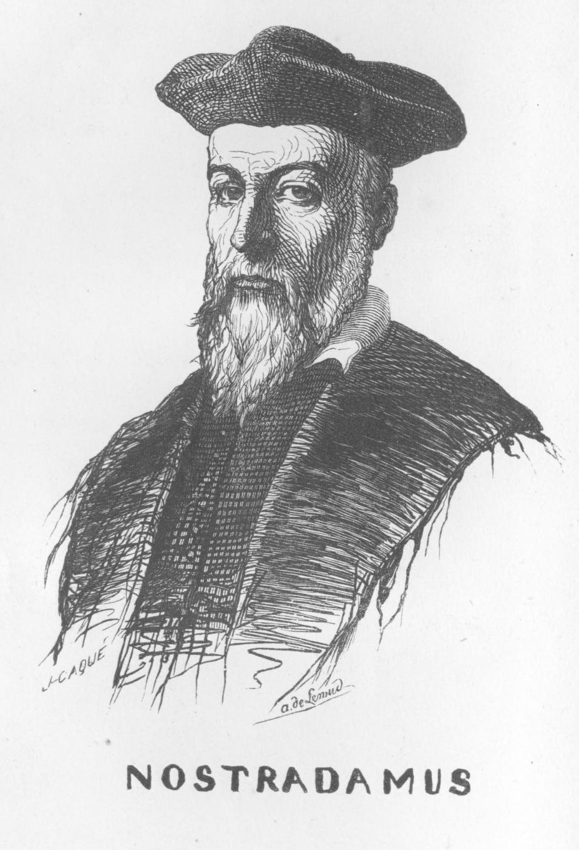
Nosterdamus Attack
Commit h.
Given any M, find r such that H(M, r) = h
Finding r: a kind of preimage?
Not exactly, in case of MD (we will see later).
Generic attack: choose r at random until we find H(M, r) = h. complexity: 2^{n}.
Why it is called Nosterdamus attack?
Commit for future event and reveal once we reach that future time point. - used for Prediction.

Slide 47
Can we have attacks better than generic attacks ??

Slide 48
Joux’s Multicollision
m₁
Notation :
h₀
h₁
f(h₀, m₁) = h₁
m₁
m₂
m_{k}
IV = h₀
h₁
h₂
h_{k-1}
h_{k}
n₁
n₂
n_{k}
k successive birthday attacks.
H(M) = h_{k} for any M = x₁x₂…x_{k} where x_{i} = m_{i} or n_{i}.
2^{k}-multicollision based on k2^{n/2} queries.

Slide 49
Application: Joux’s Multicollision
Collision for concatenated DBL Hash H || G :
2^{n/2} –way multicollision for H in O(n2^{n/2} ) complexity.
Assume G as RO. We expect a collision pair (M, M’) for G. So,
H(M) || G (M) = H(M’) || G (M’).
n2^{n/2} complexity for collision of 2n-bit hash function.
Open Problem : To find collision without assuming ROM.

Slide 50
Application: Joux’s Multicollision
Find 2nd preimage of long messages (2^{k} blocks).
Query complexity: 2^{n-k} + k 2^{n/2}.
Pre-processing step: We can use the idea of Joux’s attack to find expandable messages.
Step-1: Find a link message to the chain of the given message M.
Step-2: Use appropriate length message from the expandable message set.

Slide 51
Sponge Mode
M1
M2
M3
Mk
IV₁
Hash value
P
P
. . .
P
IV₂
drop
We have multicollision similar to MD.
Can you see this?
Preimage attack: Meet-in-the middle attack (given M and E_{K2}(E_{K1}(M)) = C, how to find K1 and K2 ?) . Here given h, find M:
2^{c/2} queries to find a preimage.

Slide 52
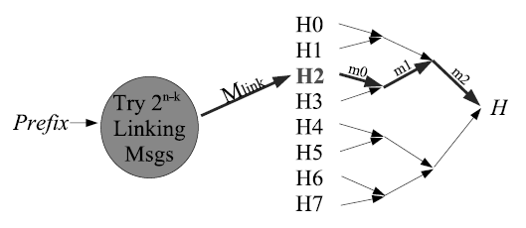
Nostradamus Attack for MD
Commit h.
Given any M find r such that H(M, r) = h
We have Diamond attack.
roughly 2 ^{n-k} + 2^{k/2 +n/2} hash queries.

Slide 53
Nostradamus Attack for MD
preprocessing step
(2^{n/2 + k/2} queries are required):
Make the tree to obtain H (root node) and commit it.
Given M compute the partial chain value h: IV →_{M} h.
Find a link Mlink s.t. h → _{Mlink}Hi for some i (here i = 2).
2^{n-k} queries are required
Let Hi → _{N} H . Then we have, IV → _{M || Mlink || N} H
i.e. MD(M || Mlink || N) = H. So r = Mlink || N.

Slide 54
Thank you
Comments and Questions ?

Slide 55
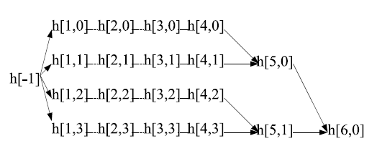
Elongated Diamond Structure

Slide 56
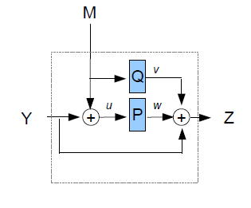
Grostl Compression function

Slide 57
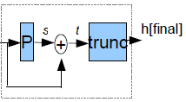
Grostl post-processor

Slide 58
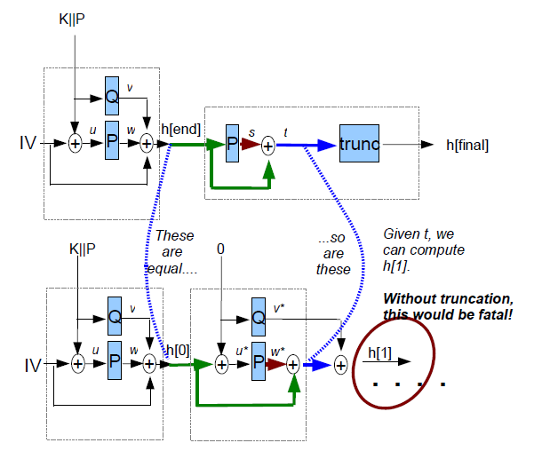
Length-Extension Attack

Slide 59
Ideal Hash Function:
Random Oracle

Slide 60
Random Oracle
An n-bit hash function H is called random oracle if for any distinct inputs M₁,.. M_{q}, H(M₁), …, H(M_{q}) are uniformly and independently distributed over {0,1}^{n}.
Hash functions are usually assumed to be a random oracle. For any distinct choices of x₁, … , x_{q} we have the birthday collision probability.
Random oracle is ideal: For any attack (not necessarily birthday attack)
Collision. query : 2^{n/2}.
Preimage, Nosterdamus attack, second preimage- 2^{n}.
k-multicollision 2^{n(k-1)/k} queries

Slide 61
Why Random Oracle Model
A public function can not have probability distribution on outputs, so the random oracles are not practical.
Easy to analyze : Many cryptosystems are based on ROM. Later on some of them are modified to a cryptosystem based on without ROM.
A suitable model for public function such as hash function.

Slide 62
Some compression functions…

Slide 63
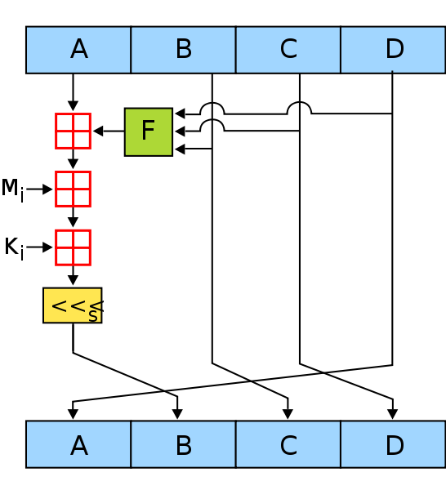
MD4 compression function
MD4 compression function f: {0,1}¹²⁸ x {0,1}⁵¹² → {0,1}¹²⁸.
F(h, m) = h’
message expansion M₁ || … M₁₆|| M₁ || .. M₁₆ || M₁ || … || M₁₆.
h = A || B || C || D. Update h 48 times as shown in figure.

Slide 64
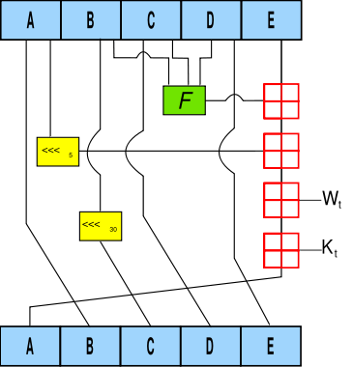
SHA-1 compression function

Slide 65
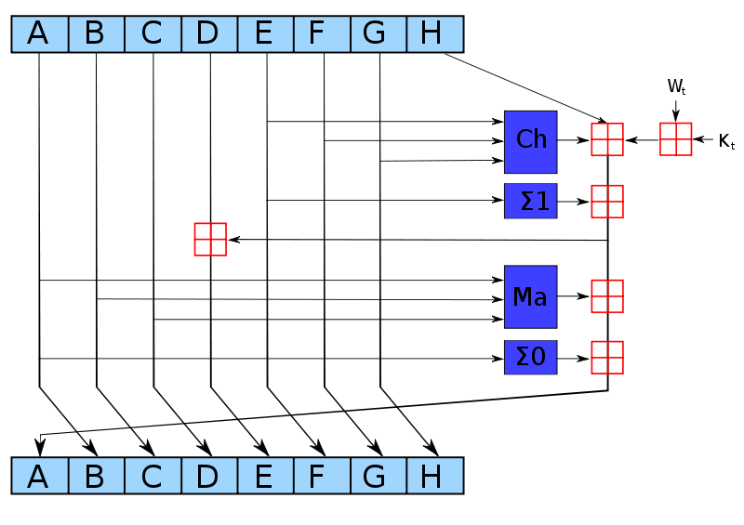
SHA-2 compression function

Slide 66
4. Generalized MD
1. Doubly iterated Merkle-Damgård Construction.
The sequence is <1,2,…, t, 1,2, …, t>
…
M_{t}
M₁
…
M_{t}
M₁
d-bit
d-bit
d-bit
f
…
f
…
f
IV
hash value
n-bit
n-bit
n-bit
n-bit

Slide 67
4. Generalized MD
2. Zipper hash function.
The sequence is <1,2,…, t, t,t-1, …, 1>
Classical MD hash function can be characterized by a sequence <1,2,…,t>.
…
M_{t}
M_{t}
…
M₁
M₁
d-bit
d-bit
d-bit
f
…
f
…
f
IV
hash value
n-bit
n-bit
n-bit
n-bit

Slide 68
Generalized MD (Nandi, Stinson IEEE’07)
Generalization of MD (sequence-based): Given any sequence a = <a₁,…,a_{s}> of {1,2,..,t} we can define a hash function F_{a} : {0,1}^{dt} → {0,1}^{n} as F_{a}(M) = h_{s} where
h₀ = IV, h_{i} = f(h_{i-1}, M[a_{i}]), i = 1,…,s, M = M[1]|| … ||M[t],
- Pad(M) = M || 10…00 || binary(|M|)₆₄ = M₁ || … || M_{t}
M_{a1}
M_{a2}
…
M_{a}
M_{a}
s-1
s
d-bit
d-bit
d-bit
d-bit
f
f
…
f
f
IV
hash value
n-bit
n-bit
n-bit
n-bit
n-bit

Slide 69
Merkle-Damgård preserves CR (Proof)
To prove this we need to prove the following:
We can write down an algorithm for
finding collision of f given a collision of H.
So assume (M, N) is a collision of H and find out a collision for f.
If |M| ≠ |N| then by looking at the final invocation of f we have a collision of f (we have a length padding).

Slide 70
Merkle-Damgård preserves CR (Proof)
If |M| ≠ |N| then M_{t} ≠ N_{s} (both contain the length) hence f(h_{t-1}, M_{t}) = f(h’_{s-1}, N_{s}) is collision.
M₂
…
M_{t-1}
M_{t}
M₁
d-bit
d-bit
d-bit
d-bit
f
f
…
f
f
IV
h_{t}
n-bit
n-bit
n-bit
h_{t-1}
n-bit
N₂
…
N_{s-1}
N_{s}
N₁
d-bit
d-bit
d-bit
d-bit
f
f
…
f
f
h
IV
h_{s}
n-bit
n-bit
n-bit
h’_{s-1}
n-bit

Slide 71
Merkle-Damgård preserves CR (Proof)
So assume |M| = |N|, i.e. s = t.
?
M_{t}
= N_{t}
M₂
…
M_{t-1}
M_{t}
M₁
?
h_{t-1}
= h’_{t-1}
d-bit
d-bit
d-bit
d-bit
f
f
…
f
f
IV
h_{t}
n-bit
n-bit
n-bit
h_{t-1}
n-bit
N₂
…
N_{t-1}
N_{t}
N₁
d-bit
d-bit
d-bit
d-bit
f
f
…
f
f
h
IV
h_{t}
n-bit
n-bit
n-bit
h’_{t-1}
n-bit

Slide 72
Merkle-Damgård preserves CR (Proof)
So assume |M| = |N|, i.e. s = t.
M_{t}
= N_{t}
M₂
…
M_{t-1}
M₁
?
d-bit
d-bit
d-bit
M_{t-1}
= N_{t-1}
f
f
…
f
h_{t-1}
IV
n-bit
n-bit
h_{t-2}
?
N₂
…
N_{t-1}
h_{t-2}
= h’_{t-2}
N₁
d-bit
d-bit
d-bit
d-bit
f
f
…
f
IV
h_{t-1}
n-bit
n-bit
h’_{t-2}

Slide 73
Merkle-Damgård preserves CR (Proof)
So assume |M| = |N|, i.e. s = t.
M_{t}
M_{t}
= N_{t}
= N_{t}
M₁
d-bit
M_{t-1}
M_{t-1}
= N_{t-1}
f
= N_{t-1}
IV
h₁
n-bit
n-bit
N₁
?
M₁
= N₁
d-bit
IV
f
h₁
n-bit
n-bit

Slide 74
Merkle-Damgård preserves CR (Proof)
We have (M₁, … , M_{t}) = (N₁, …, N_{t}). This implies that M = N (see the padding rule) and hence contradiction.
M_{t}
M_{t}
= N_{t}
= N_{t}
M₁
d-bit
M_{t-1}
M_{t-1}
= N_{t-1}
f
= N_{t-1}
IV
h₁
n-bit
n-bit
N₁
M₁
= N₁
d-bit
IV
f
h₁
n-bit
n-bit

Slide 75
Joux’s Multicollision
What we will do if we do not get collision at some stage after 2^{n/2} tries?.
We make sufficient number of queries.. Even if we do not get we abort
step back or
change chaining value
What we will do if d < n/2 ?
We combine two or more blocks so that message size in combined block is at least n/2.

